Slide 1

DATA MINING PROJECT AIRLINES CUSTOMER SATISFACTION SYSTEM
PRAGATHI S

Slide 2
Problem Statement
The airline industry faces the challenge of maintaining customer satisfaction in a dynamic market where passengers’ service expectations are constantly evolving. Airlines must identify which service features are most valued by passengers to improve satisfaction and loyalty effectively to maximize their profit.
Objective
The project aims to:
1.Identify critical service attributes that influence passenger satisfaction. Build a robust predictive model to classify passengers as "satisfied" or "dissatisfied/neutral" based on service features.
2.Provide actionable insights to airline management on which service aspects to prioritize for enhancing customer satisfaction.

Slide 3
Dataset Overview
Dataset Used: Airline Passenger Satisfaction
Context: This dataset contains an airline passenger satisfaction survey. What factors are highly correlated to a satisfied (or dissatisfied) passenger?
Content:
1.Gender: Gender of the passengers (Female, Male)
2.Customer Type: The customer type (Loyal customer, disloyal customer)
3.Age: The actual age of the passengers
4.Type of Travel: Purpose of the flight of the passengers (Personal Travel, Business Travel)
5.Class: Travel class in the plane of the passengers (Business, Eco, Eco Plus)
6.Flight distance: The flight distance of this journey

Slide 4
7.Inflight wifi service: Satisfaction level of the inflight wifi service
8.Departure/Arrival time convenient: Satisfaction level of Departure/Arrival time convenient
9.Ease of Online booking: Satisfaction level of online booking
10.Gate location: Satisfaction level of Gate location
11.Food and drink: Satisfaction level of Food and drink
12.Online boarding: Satisfaction level of online boarding
13.Seat comfort: Satisfaction level of Seat comfort
14.Inflight entertainment: Satisfaction level of inflight entertainment
15.On-board service: Satisfaction level of On-board service
16.Leg room service: Satisfaction level of Leg room service
17.Baggage handling: Satisfaction level of baggage handling

Slide 5
18.Check-in service: Satisfaction level of Check-in service
19.Inflight service: Satisfaction level of inflight service
20.Cleanliness: Satisfaction level of Cleanliness
21.Departure Delay : Minutes delayed when departure
22.Arrival Delay : Minutes delayed when Arrival
23.Satisfaction: Airline satisfaction level(Satisfaction, neutral or dissatisfaction)

Slide 6
Airline Passenger Satisfaction Project Roadmap
1. Data Understanding
Load and inspect the data
Understand the structure, types, and meanings of columns
Check for class distribution (e.g., satisfied vs. neutral/dissatisfied passengers)
2. Data Preprocessing
Handle missing values
Convert categorical features (Label Encoding / One-Hot Encoding)
Normalize or scale numerical features
Split into training and testing sets
3. Exploratory Data Analysis (EDA)
Summary statistics and distributions
Visualizations:
Pie chart of satisfaction levels
Kde or correlation heatmap
Boxplots to see feature effects on satisfaction

Slide 7
4. Model Building
Train classification models:
Logistic Regression
Decision Tree
Random Forest
XGBoost
Evaluate models using:
Accuracy, Precision, Recall, F1-Score
Confusion matrix
5. Model Interpretation & Feature Importance
Identify which features most influence satisfaction
SHAP or feature importance from tree-based models
6. Conclusion
Summarize key findings and model performance
Suggest improvements or business recommendations

Slide 8
Data Preprocessing
Handling Missing Values: Missing values in 'Arrival Delay in Minutes' were filled with the median due to their skewed distribution
Removing Unnecessary Columns: Non-predictive columns like 'id' were removed. 'id' is typically a unique identifier not useful for analysis.
Outlier Handling: Extreme values in continuous features like 'Flight Distance,' 'Departure Delay’, and 'Arrival Delay ' were detected and removed and capped.
Changing the data type: 'Flight Distance' to numeric
Encoding: Encoding categorical features using Label Encoding

Slide 9
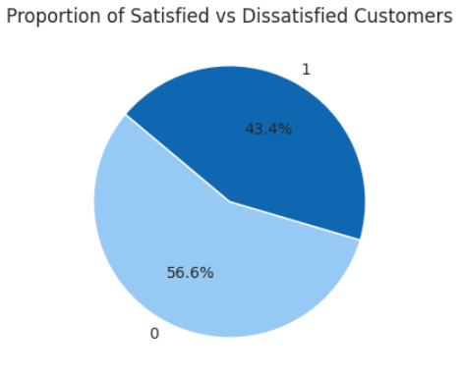
Exploratory Data Analysis (EDA)
The proportions of 'satisfied' and 'dissatisfied' customers, revealing an approximately balanced distribution with 43% satisfied.
Insights from the next graph:
Class: Business Class passengers show higher satisfaction; Economy classes have more dissatisfaction.
Gender: Both males and females lean towards dissatisfaction.
Customer Type: Disloyal customers are mostly dissatisfied; loyal customers are more balanced.
Type of Travel: Business travelers are generally more satisfied; personal travelers show more dissatisfaction.
Age: Older passengers tend to be more satisfied, while younger passengers have mixed satisfaction.

Slide 10
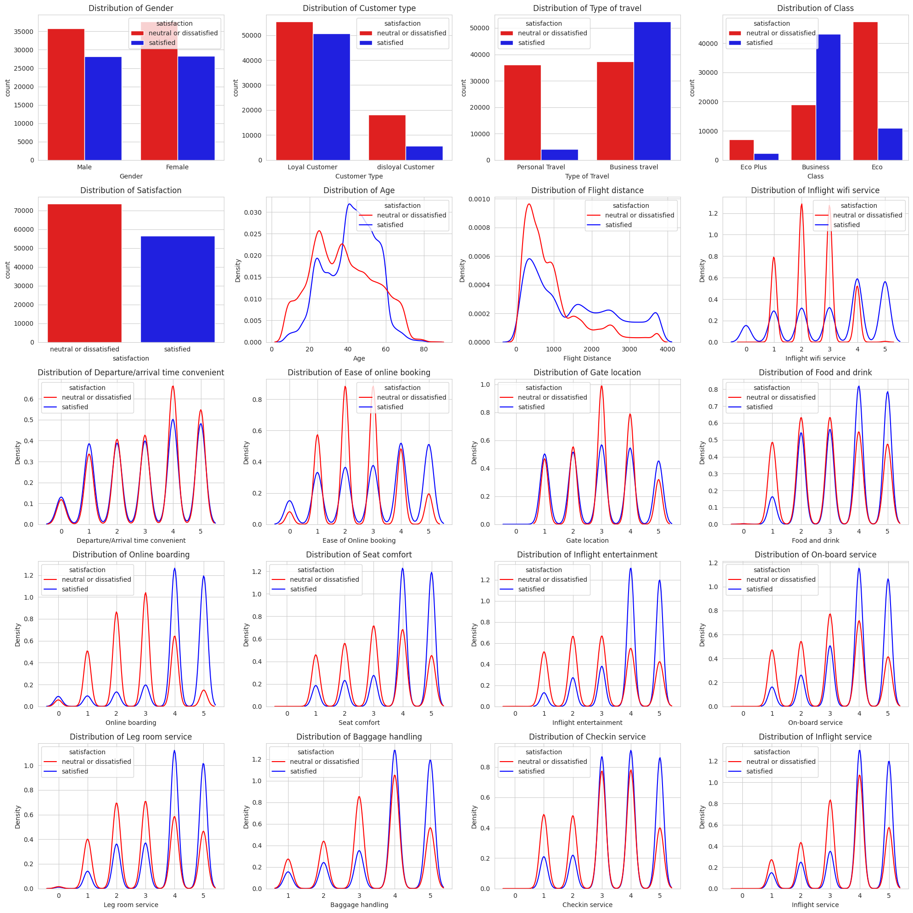
Some other insights from the graph:
Flight Distance: Longer flights correlate with higher dissatisfaction.
Inflight Wi-Fi Service: Poor Wi-Fi ratings lead to dissatisfaction.
Seat Comfort: Low seat comfort is a strong factor in dissatisfaction.
Food and Drink: Poor food ratings contribute to dissatisfaction.
Online Booking: Difficult booking processes increase dissatisfaction.
Inflight Entertainment: Limited entertainment options result in dissatisfaction

Slide 11
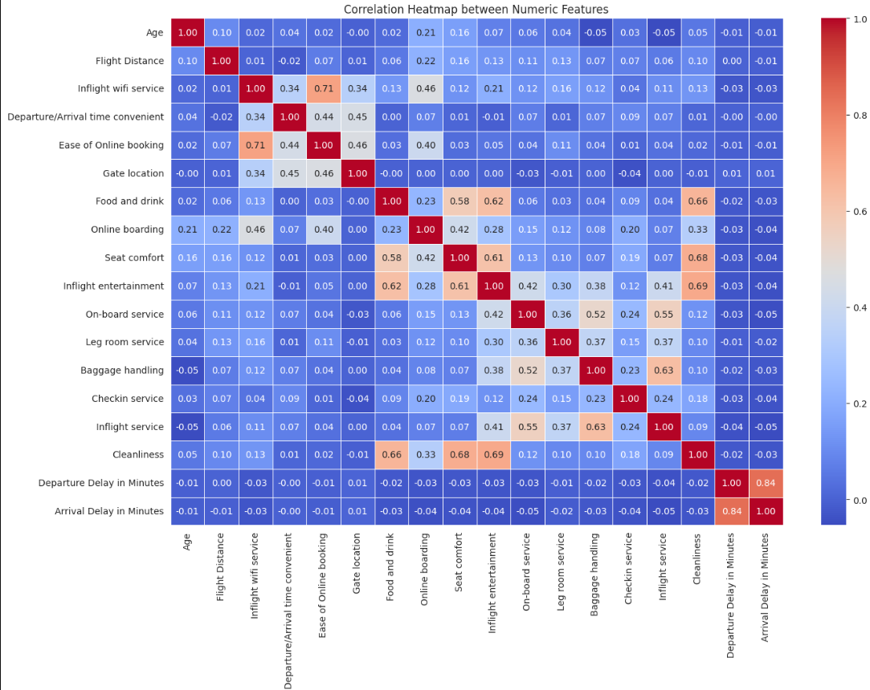
Feature Engineering
Encoding Categorical Variables: Categorical features like 'Gender,' 'Customer Type',' Gender' and 'Satisfaction' were label-encoded for compatibility with machine learning models.
Correlation Analysis: Pearson correlation was calculated to identify highly correlated features.
Check-in Service and Inflight Service: High correlation; passengers who rate one highly tend to rate the other highly as well.
Departure and Arrival Delays: High correlation; longer departure delays often lead to longer arrival delays.

Slide 12
Model
In this project we used model to conduct a comparative study, aiming to analyze difference in accuracy. We assessed the models based on their accuracy, precision, recall score, f score. Models that we have used are:
Logistic Regression
Decision Tree
Random Forest
Xgboost
Naive Bayes
KNN

Slide 13
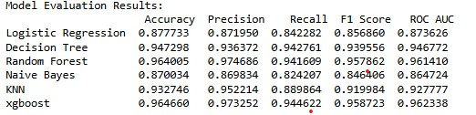
Result

Slide 14
Conclusion
This project successfully developed a predictive model for airline customer satisfaction using various machine learning techniques. After evaluating multiple models, Random Forest emerged as the best-performing model, achieving an accuracy of 95.8%. This high accuracy underscores the model’s ability to capture complex relationships and interactions between features that influence customer satisfaction. The analysis highlighted key satisfaction drivers, such as travel class, customer loyalty, and service quality (e.g., inflight entertainment, seat comfort, and punctuality). These insights provide valuable guidance for airlines aiming to enhance customer experiences by focusing on areas that directly impact satisfaction.

Slide 15
THANK YOU

